Slide 1
Script Files

Slide 2
Script Files
All of the pre-built commands that you use in MATLAB® are script files or functions (plot, mean, std, exp, cosd, …)
MATLAB® allows the user to create his/her own customized m-files for specific applications or problems.
A script file is simply a collection of executable MATLAB® commands. To create a new script file, click on the New Script icon on the left side of the Home Tab.

Slide 3
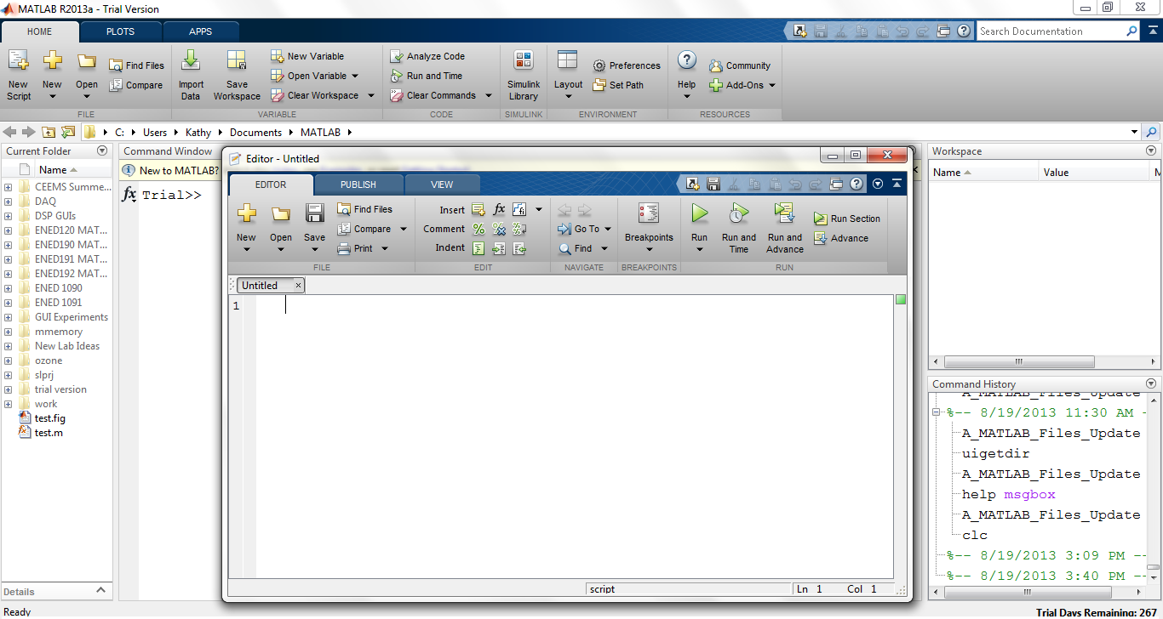
Script Files
Click on New Script
Creates Blank Script File

Slide 4

Script File: Procedure
Type a set of executable commands in the editor window.
Save the file in an appropriate folder. When you pick a name for the file you must follow the same rules that MATLAB has for naming variables.
Set the current directory in MATLAB® to the same place where you saved the script file.
To run the script file: Hit the Green Run Arrow in the Editor window or simply type the name of the file (without the .m extension) at the command prompt in the MATLAB command window.
The file must be in your current directory or
it will not run!

Slide 5
Exercise 1: New Script File
Right click in the current folder window in MATLAB and create a new folder named whatever you would like.
Double click on the folder to make it your current folder.
Clear your MATLAB workspace by typing clear at the command prompt.
Click on New Script to open a blank script file.
Type the commands on the next slide into the editor window then save the file as CircleScript in your newly created folder.

Slide 6
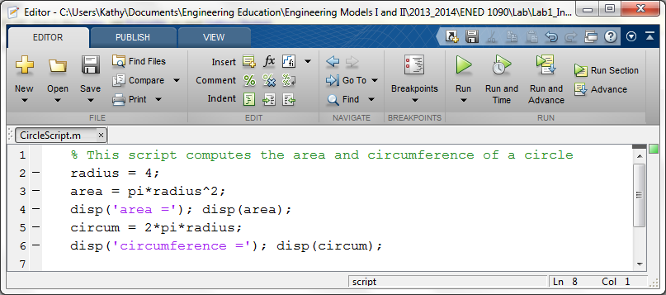
Exercise 1: Script File
Save the file as CircleScript in your newly created folder.
Note: Any line that starts with a % is a comment and
turns green – it doesn’t execute.

Slide 7
Exercise 1: Run the Script File
Now run your script file by clicking on the Green Arrow in the m-file editor window.
Notice that every single variable defined in the script file (radius, area, and circum) appears in the Workspace Window. Area and circum are also displayed in the Command Window because of the disp command.
Clear the workspace window by typing clear at the command prompt.
At the command prompt, type the name of your script file: >> CircleScript. Note, that the results are exactly the same as before.

Slide 8
Script Files
A script file is simply a set of executable MATLAB commands saved together in a file. It behaves exactly the same as entering each command sequentially in the command window. Every single variable defined appears in the workspace.
Script files can be really useful if you are going to execute a lot of MATLAB commands. For example, suppose you execute 15 commands at the command prompt and discover an error in the first command that affected the last 14 commands. In the command window, you would have to fix the error in the first command then run the other 14 commands over again. If these commands were in a script file, you could fix the first command and re-run the script file – much faster !!

Slide 9
Exercise 2: Another Script File
Create a new script file called SphereScript that will compute and display the surface area and the volume of a sphere.

